Slide 1
Powertrain Automation System
Sai Gudapati

Slide 2
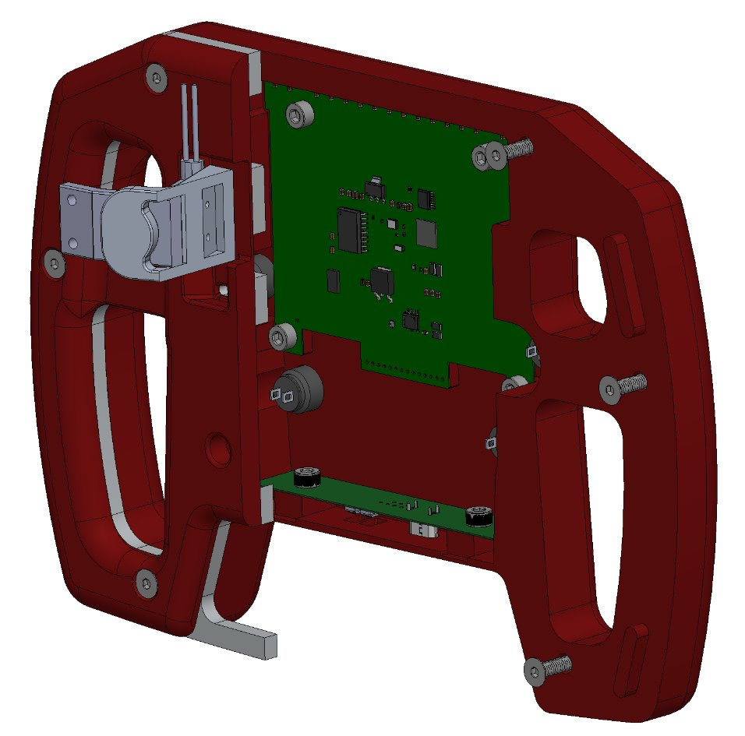
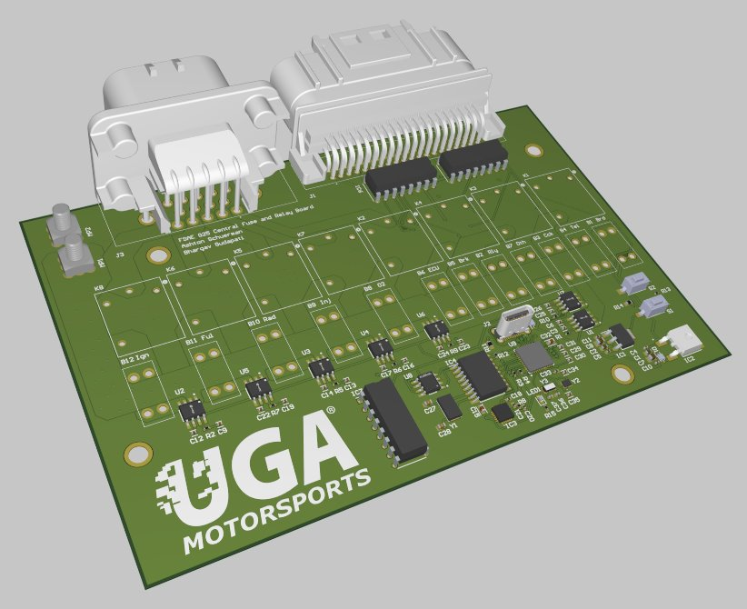
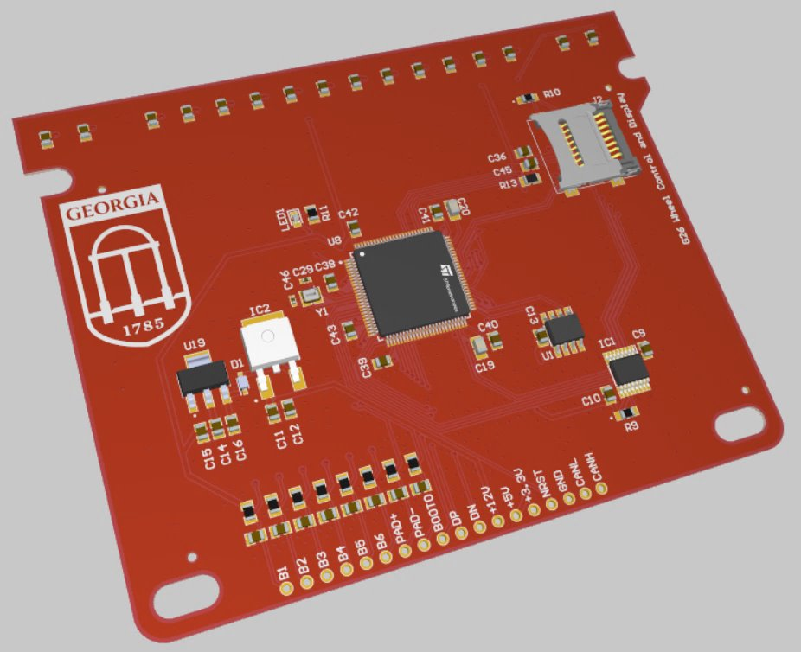
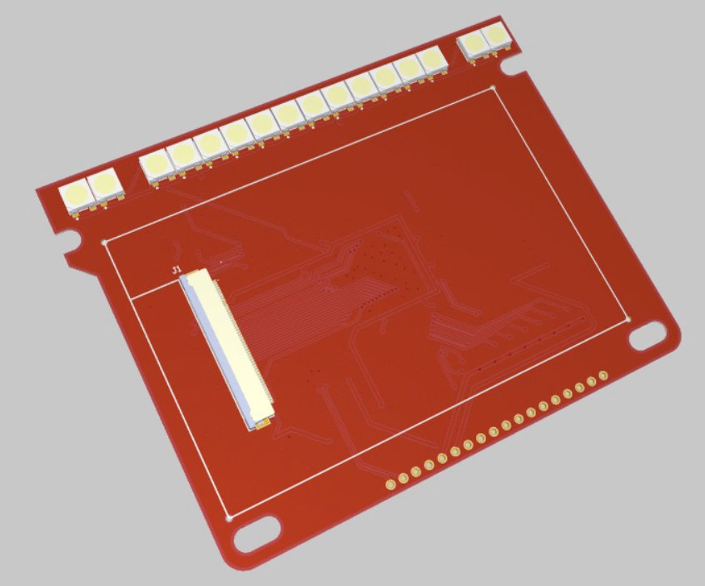
Previous activities
Work on my FSAE team consisted of both hardware and software for the last three years.
Hardware design - consisted of PCB design and manufacturing
Designs and simulations done in Altium and KiCad, further validations done with LTSpice
Software design - All of our previous systems have used the STM32 family of microcontrollers.
Programmed initially using Arduino IDE, and later STM32Cube toolchain. (C, C++)

Slide 3
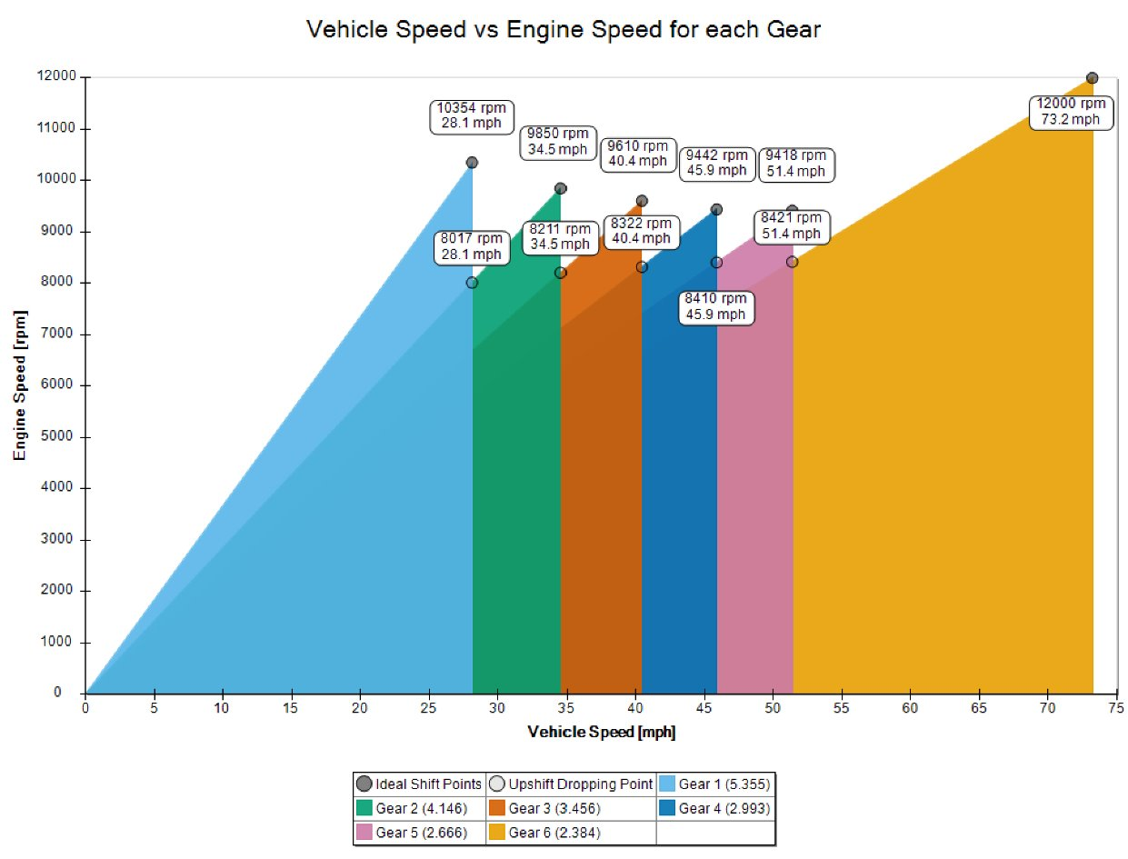
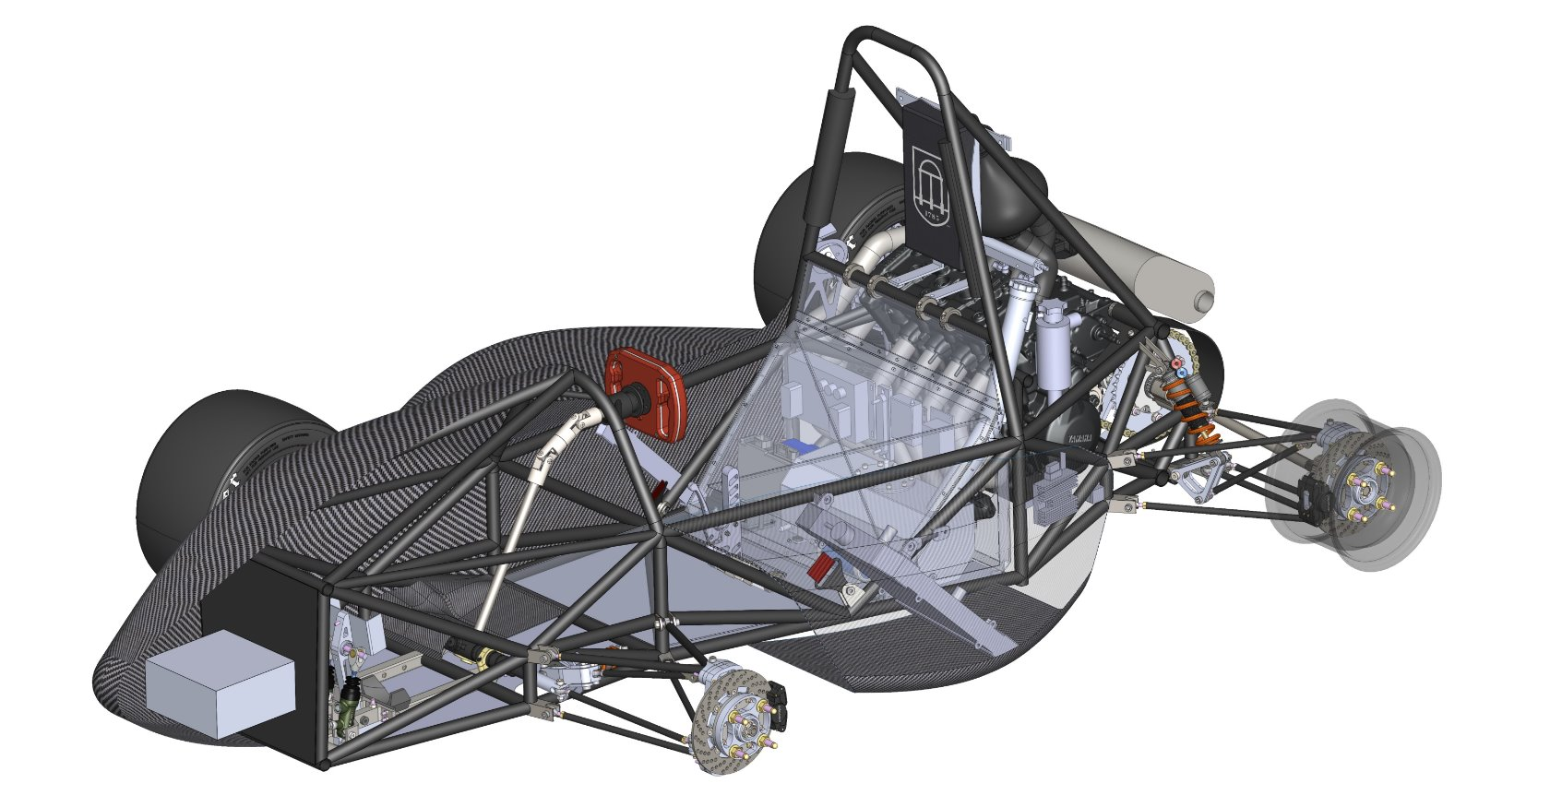
Powertrain Automation System - Overview
Our past cars used manual controls to actuate driver inputs.
E.g. our 2025 model car had manual mechanical throttle, manual lever-actuated clutch, and lever actuated shifter.
This results in significant driver fatigue, and reliance on driver training to optimally drive the car.
Our goal for this year - introduce hardware/software automation of these systems for increased driving performance.

Slide 4
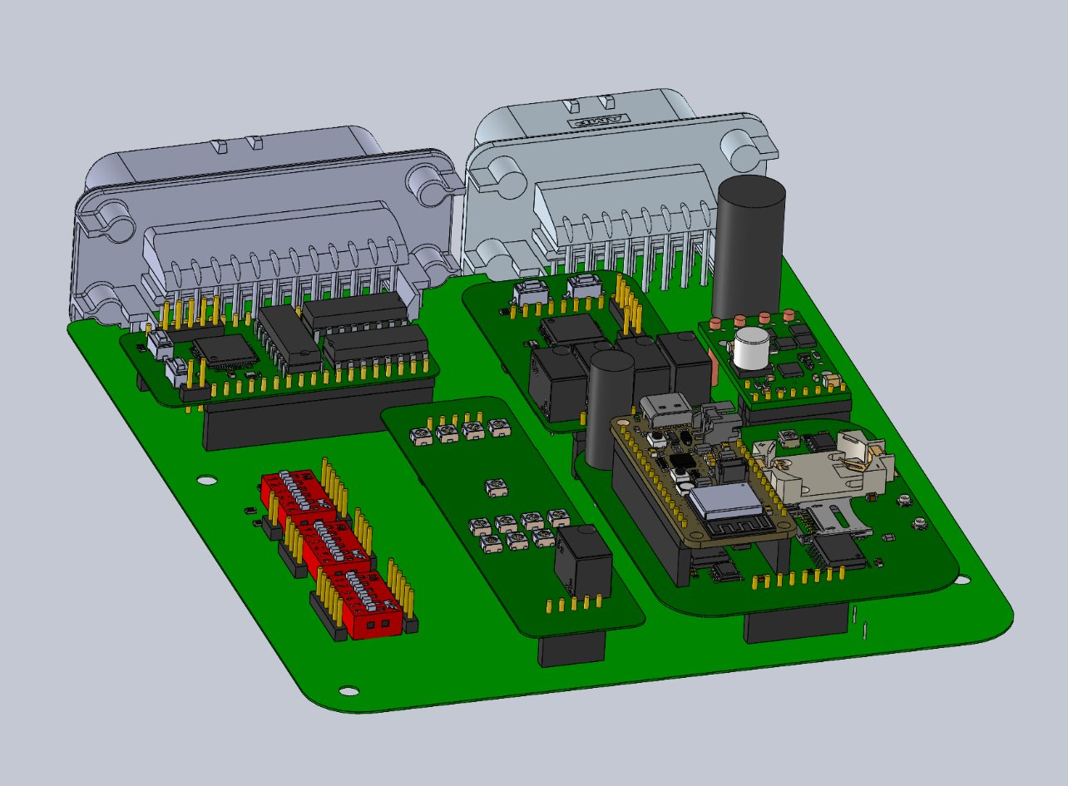
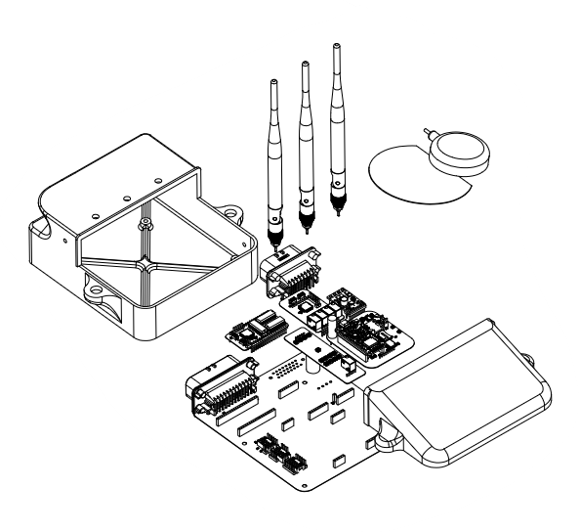
Overall system goals
Two main features were automated with a newly introduced system
Transmission shifting and actuation
Throttle body
System designed to be as easily repairable as possible
Tasks should be split up and modularized
One task = one module
Modules should be adaptable to work with existing systems on car.

Slide 5
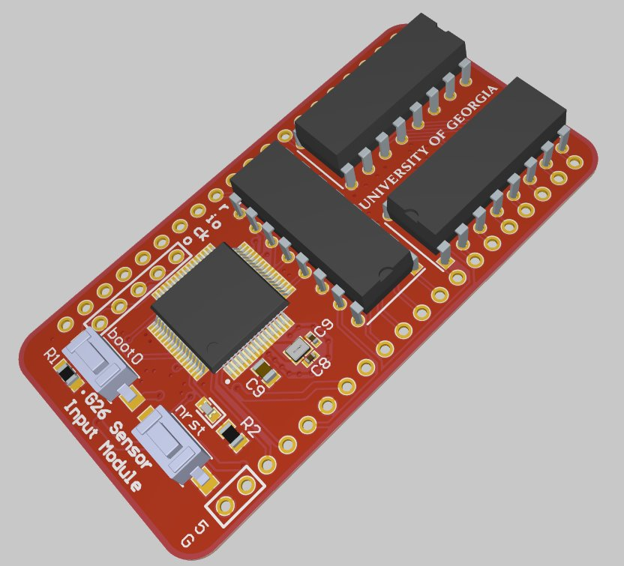
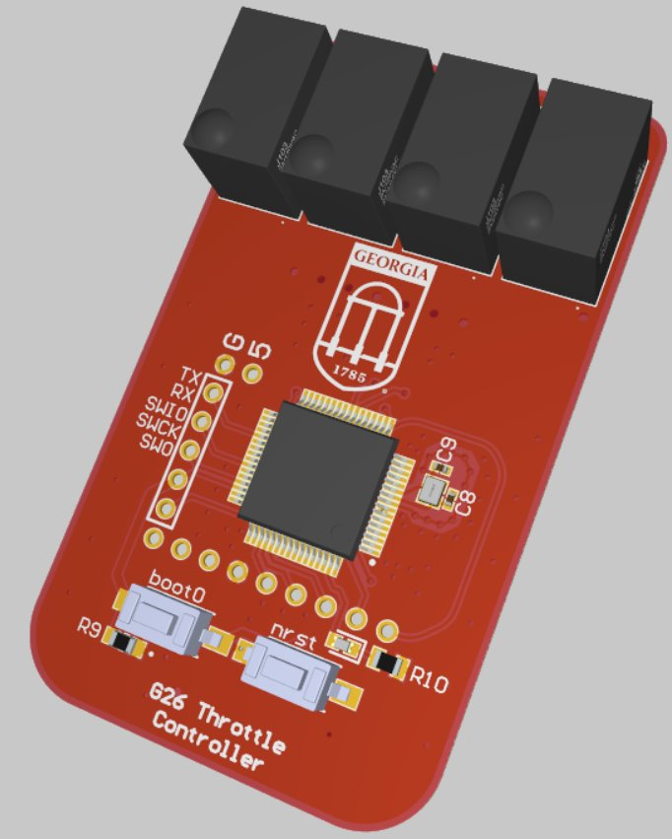
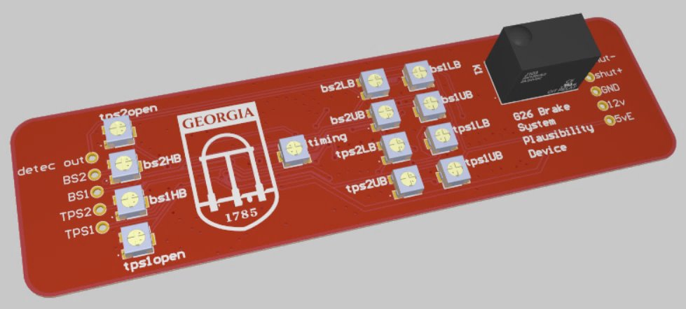
System components
Three major modules -
Sensor Input Module
Converts analog sensor inputs into digital data
Throttle and Transmission Controller
Actuates transmission solenoids and throttle body flap
Non-Programmable Safety Device
Monitors analog sensors to maintain safety.
Separation of concerns - having many separate modules allows each individual module to be more simple, and thus easier to implement and debug.

Slide 6
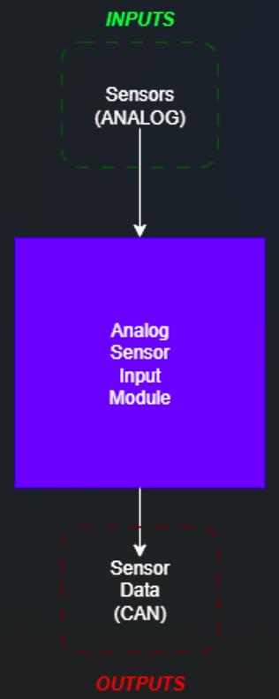
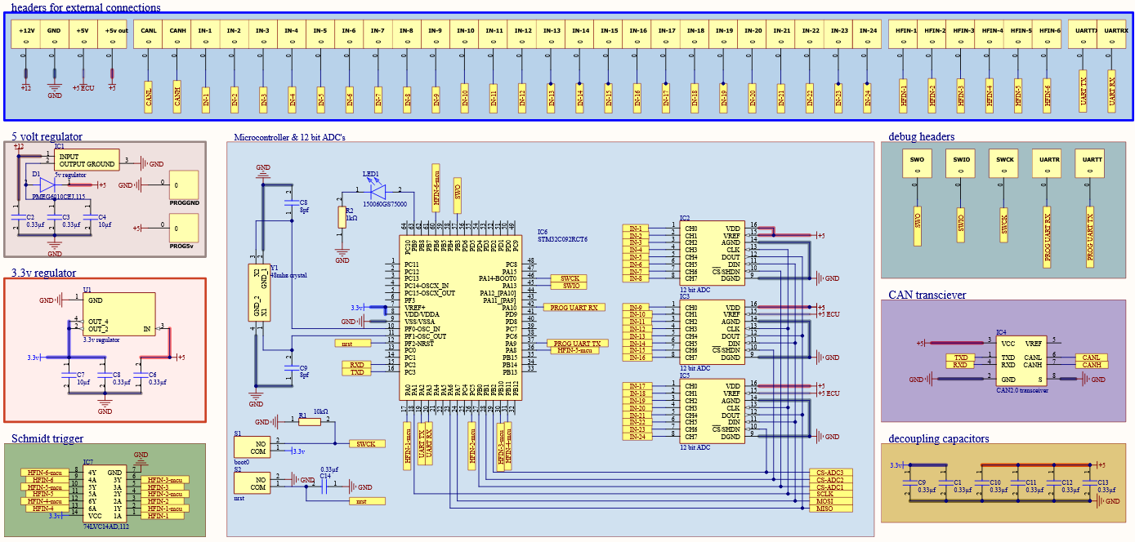
Sensor input module - hardware
Utilizes the Stm32C0 microcontroller.
Integrates three analog-to-digital conversion chips.
Integrated CAN transceiver chip for external communication.
Makes use of internal CAN peripheral of the stm32.
Supports 24 analog inputs
Includes Schmitt-trigger input chip to measure pulsing input sensors.

Slide 7
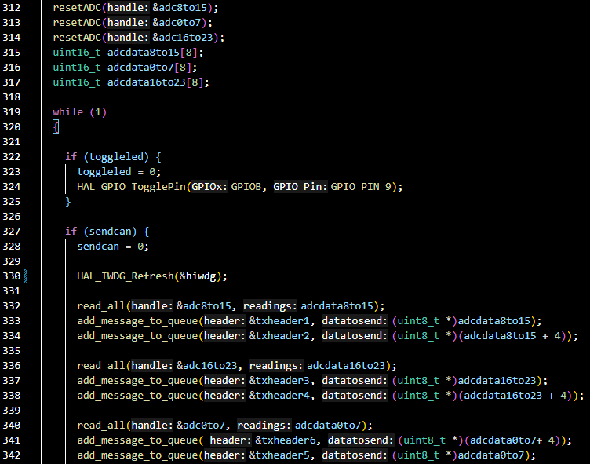
Sensor Input Module - Software
Uses the stm32cube toolchain.
Bare metal loop
only one loop where all sensors are read, processed, and then sent out over the CANbus.
Uses timer interrupts to time and process CANbus message sending
Very minimal processing happens on this module, designed to send out raw analog data points only.

Slide 8
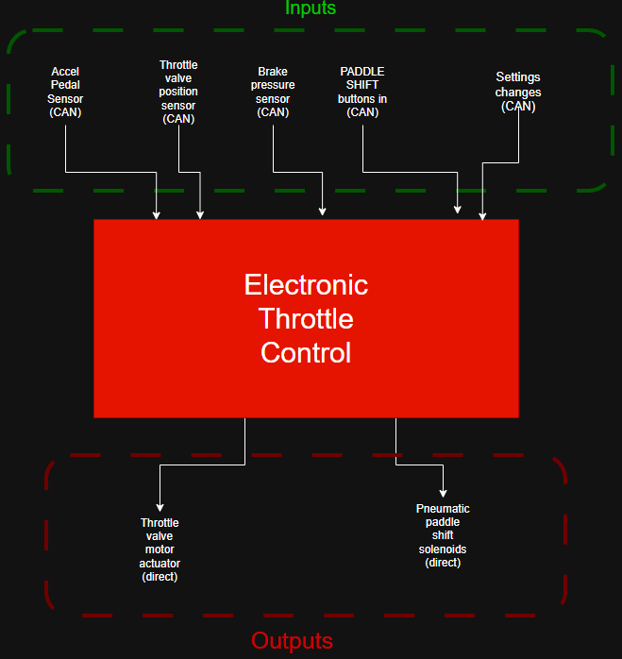
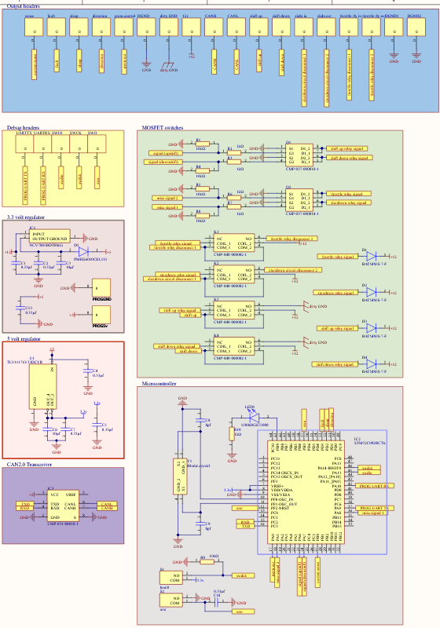
Throttle and Transmission Controller - hardware
Uses the same STM32c0 microcontroller as the Sensor Input Module
Receives all sensor data from throttle and transmission via CANbus.
4 Relays
Two relays for upshift/downshift solenoids
One relay toggling throttle power.
One relay toggling car main power.
1 PWM output
Used to control brushed motor of throttle body

Slide 9
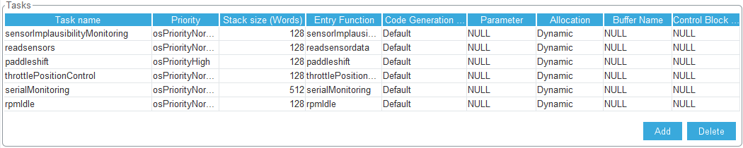
Throttle and Transmission Controller - Software Overview
Using same stm32 cube toolchain as the sensor input module.
Programmed on top of FreeRTOS
Each task got its own thread
Implausibility checking
All safety-critical sensors are periodically checked to ensure that car systems are functional
Constant debug output for easy monitoring during repair.

Slide 10
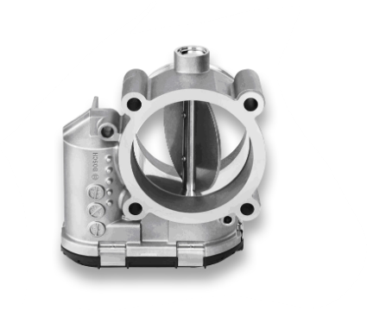

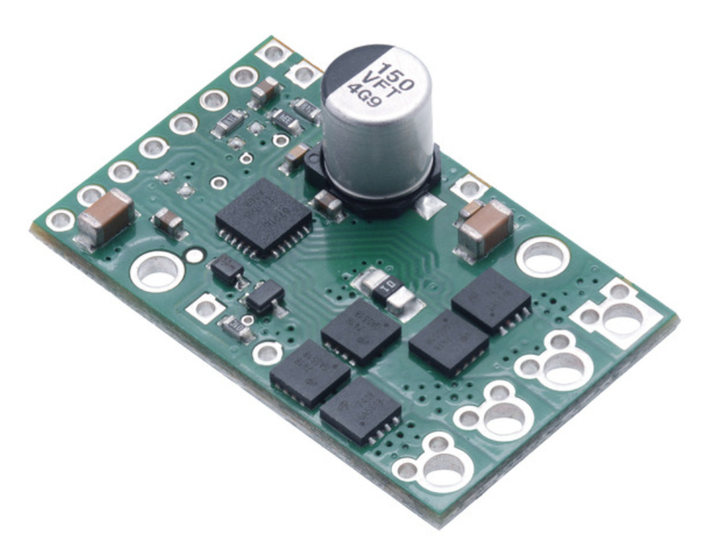
Throttle and Transmission Controller - PID control
Using Bosch throttle body
Brushed DC motor, controlled by external H-Bridge motor controller.
Includes dual throttle position sensors, connected to the Sensor Input Module.
PID control - Proportion, Integral, Derivative
Mathematical process to control a system through sensor feedback.
Throttle body flap position monitored via position sensors on the throttle, motor power changed accordingly to actuate flap to target position.
Constants are tunable to allow for optimally fast throttle actuation.

Slide 11
Throttle and Transmission controller - safety checks
Three rules-required safety checks
CANbus communication failure
Controller fails to receive data from Sensor Input Module for a long time
Data corruption failure
Received data is not plausible / dual sensors do not agree with each other
Throttle actuation failure
Throttle is detected to not be opening/closing to the intended position
Monitors gas pedal, brake pedal, and throttle position to ensure all are in working order.

Slide 12
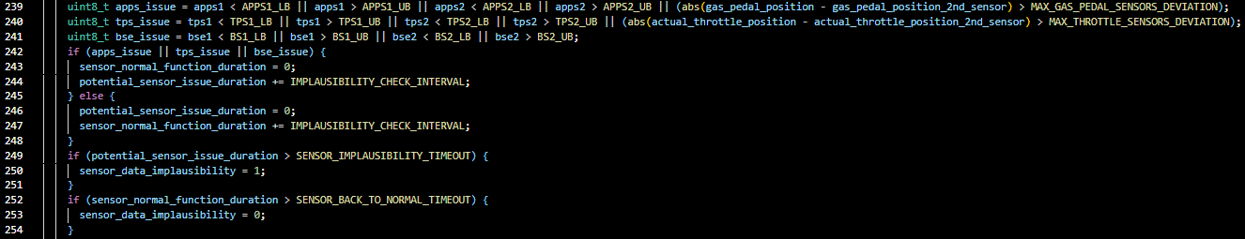
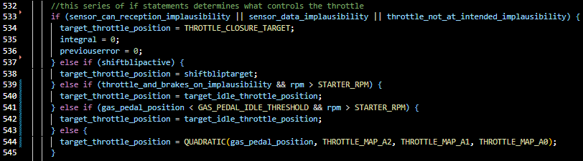
Throttle and Transmission Controller - safety checks

Slide 13
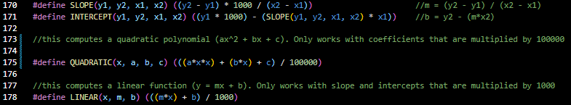
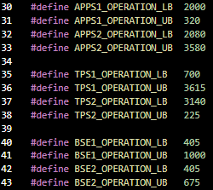
constants.h file
No numeric literals were used in the writing of the logical code.
All possible values are defined in a separate file, easily listed to be changed
Useful for quick updates and recompilation without affecting main code body
Included commonly used mapping functions.
LINEAR - used for mapping raw sensor values to percentages
QUADRATIC - used to map gas pedal position to throttle position

Slide 14
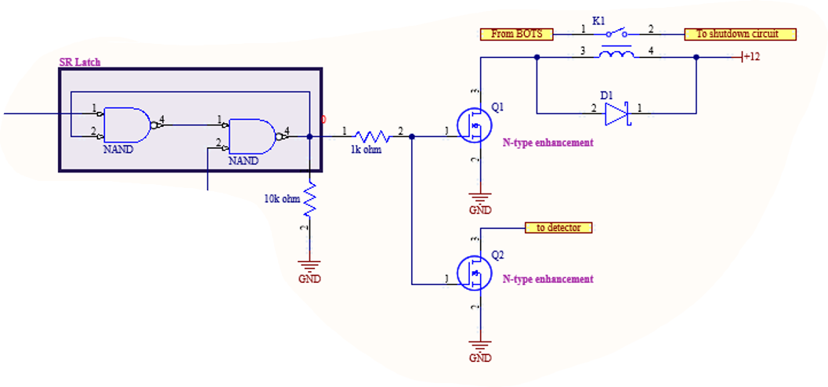
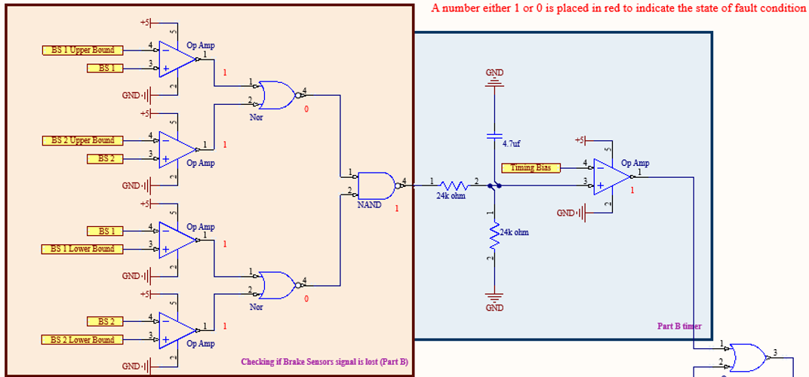
Non-Programmable Safety Device
A standalone non-programmable circuit that is used to monitor raw analog values from sensors, and determine if the car is in a safe state to drive
Monitors throttle position sensors and brake pedal sensors
If the throttle is detected to be open, and brake pedal is pressed for more than one second, the car must shut off.
Required by FSAE handbook rules to be separate.
Required to have method of directly shutting off main car power.

Slide 15
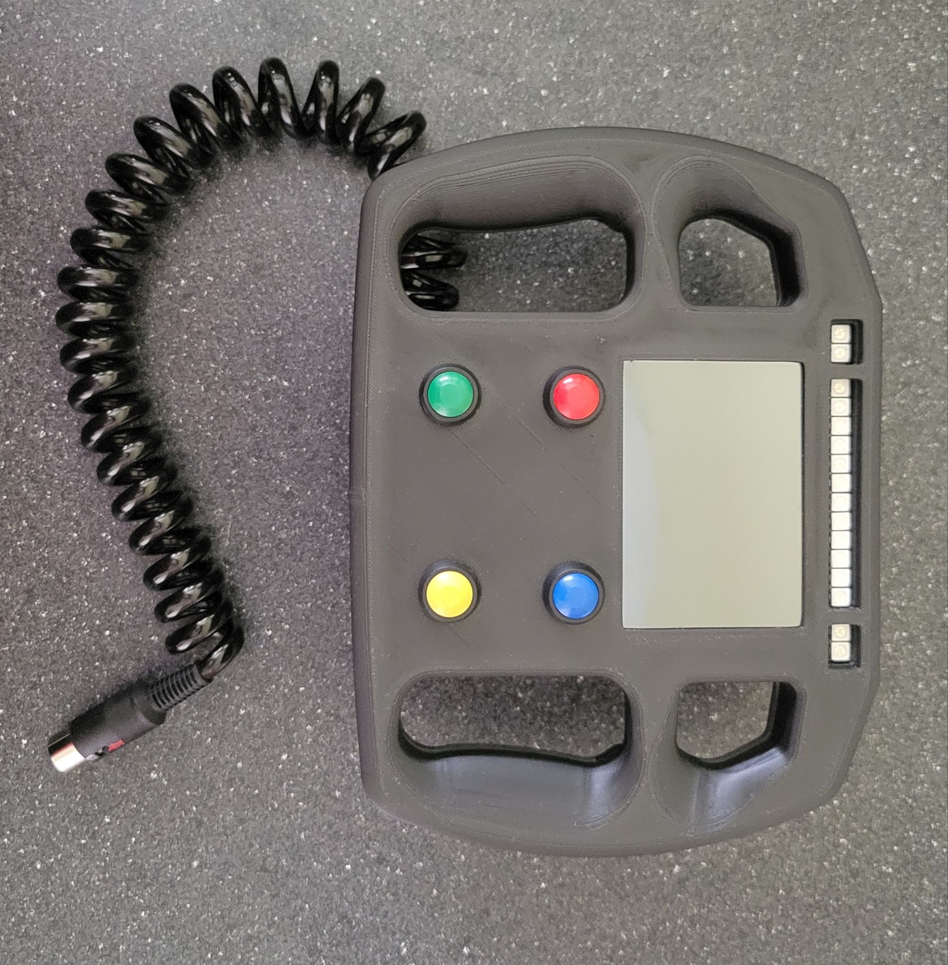
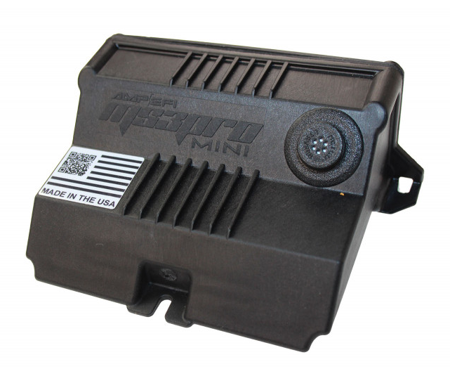
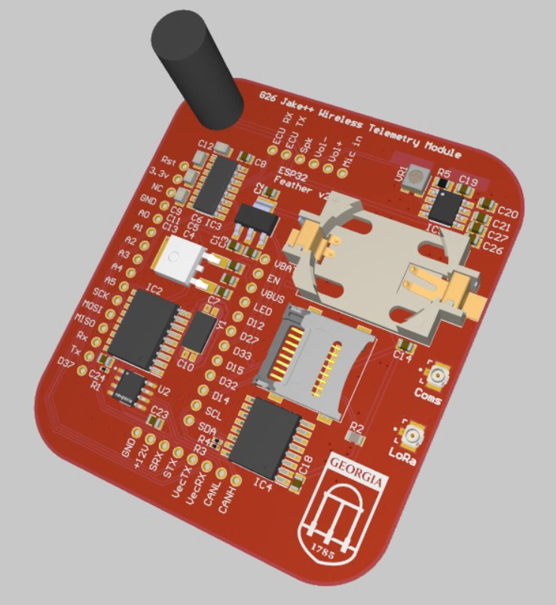
Placement with rest of car’s systems
These modules (and overall system) are not in isolation
Must work in cooperation with existing systems on the car.
CANbus interface
All systems are tied together via CANbus, to allow for joint communication
All possible sensor / car metrics data are sent over the CANbus, for any module to read and use.

Slide 16
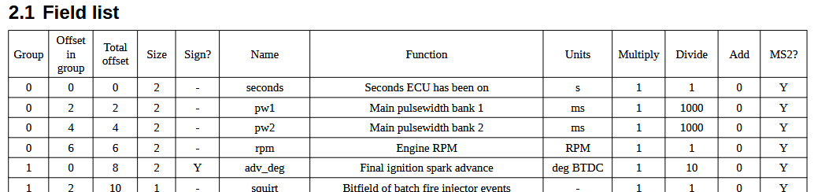
Communication protocols
System must communicate with the engine control unit for critical engine data.
Engine speed, coolant temperature
Shift cut
Canbus is used to send ignition cancellation command to the engine control unit, to allow transmission to shift.
Call-and-Response system with dashboard wheel.
For paddle shift buttons over CANbus, an acknowledgement system is used to send transmission shift signals to the Transmission controller.

Slide 17
Timeline
Whole system was built over the course of one school year.
First semester - designing schematics and circuit boards.
Included designing the overall architecture, and choosing necessary components.
Second semester - assembly and software implementation
Mainly consisted of iterating through code revisions (March - May)
Main points of interest
Tuning feedback constants to allow for accurate throttle control
Setting proper automatic delays for smooth upshift and downshift.
Ensuring all safety checks pass FSAE rules as intended, in both the Throttle controller and the non-programmable safety device

Slide 18
Lessons learned
Software often takes much longer than expected to develop
A two-month timeline was very short for the amount of new systems we introduced into our car.
You can not always reasonably predict what issues you run into
With embedded systems, possible issues are two-fold:
Hardware - many issues initially with the wiring of our car, particularly the CANbus network wiring.
Software - difficult to debug software without tools of convenience (JTAG, STLINK, etc.)

Slide 19
Future work
Results from FSAE event this year - placed roughly in the same spot.
While our system was promising, there were many hardware issues that prevented us from seeing the full benefit of our system
During the endurance event at the competition, much of our system was disabled on purpose.
Results from work shortly after competition - much more promising
Multiple testing days took place over the last 2 months, with better results:
Reliable upshift and downshifting, without lurching
Automatic engine idle
Ability to monitor system via Bluetooth.
With systems working more reliably, driver fatigue and car performance has increased.
Particularly for accel, automatic shifting allows for continuous high power output.
Reduced driver fatigue during long driving events.
Simulated 28th placement

